Slide 1
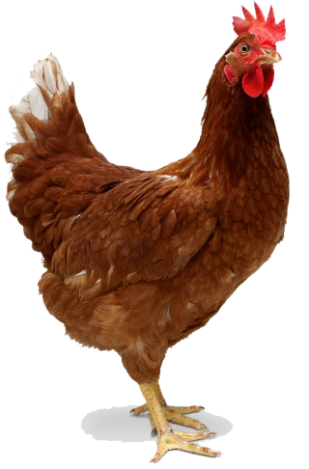
The prevalence of diseases or parasites in native chickens based on their environment
Fazl Nazheef LVL 10

Slide 2
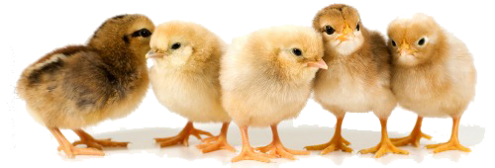
Introduction
The current chicken market
Chickens are an essential part of Indonesia’s daily meal. With around 14 kg meat consumption for each capita in 2021. With that in mind, we might need to improve on the chicken’s production rate.
Problems with chicken production
Although chickens are easy to produce, raising them is not as simple. Because even the smallest mistake could kill the chickens especially when they were just born. There 3 main factors that needs to be monitored is ventilation, temperature, and lighting. But there is also one thing that is needed to be kept in mind and that is the parasites or diseases.

Slide 3
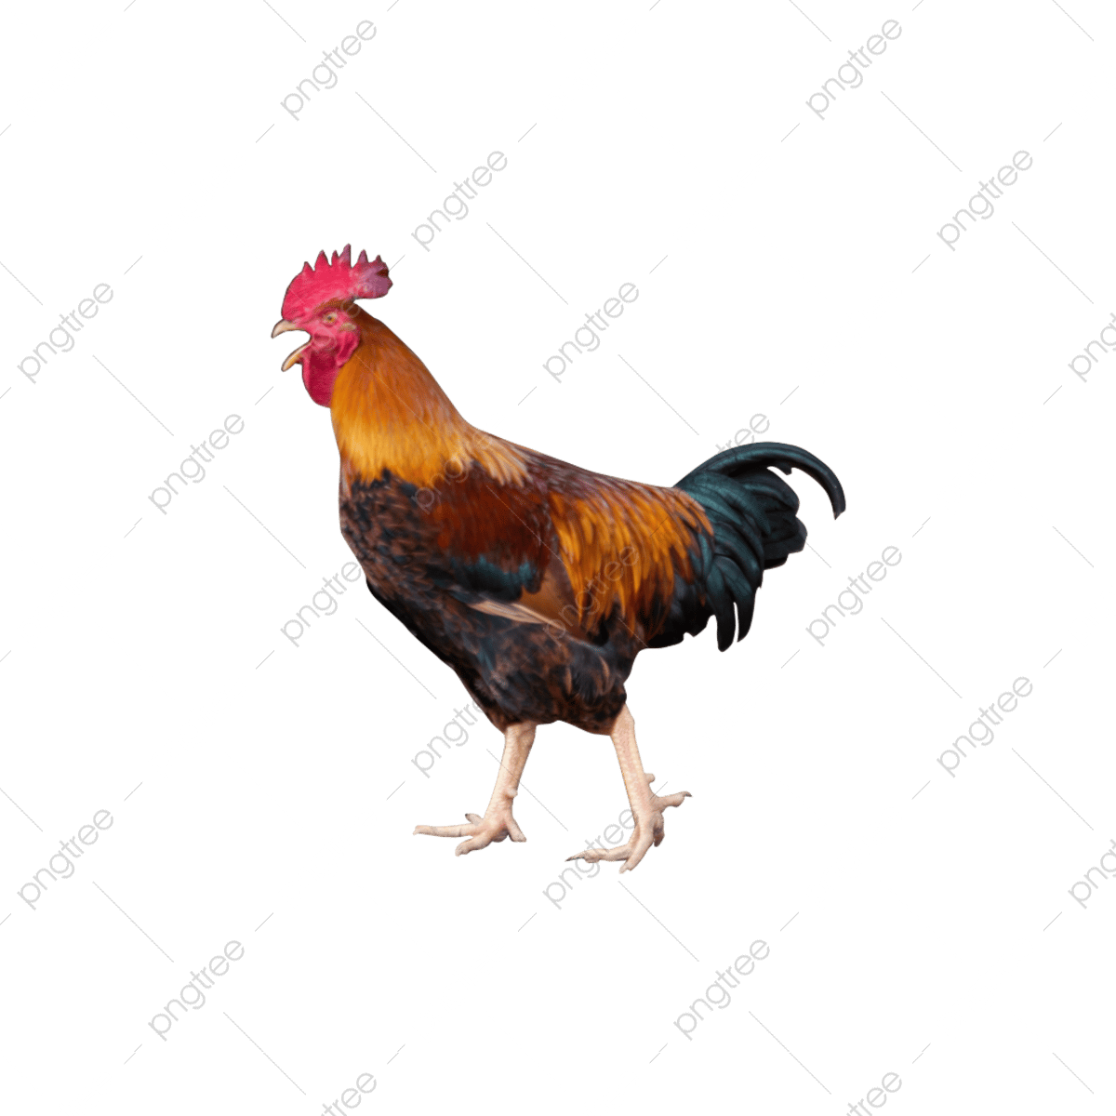
Problem
The rates of parasites appearing
Parasites or diseases in chickens can originate from food, humans (due to poor handling practices), or the environment. The environment plays a significant role in their prevalence, like Salmonella spp., which thrive in warmer temperatures and decrease in colder ones. Understanding the right environment is crucial to improving chicken production rates.
Benefits of research and study
This research aims to identify the optimal environment to keep chickens free from diseases or parasites, improving their production rate. Understanding this optimal environment is essential for future adaptability and ensuring the chickens' survivability amid climate and environmental changes.

Slide 4
Literature review
The usual temperatures for chickens in coops
The ideal temperature for the regular chicken coop is around 20-27°C (68-80°F).
The rates of parasites appearing
Parasites or diseases in chickens can originate from food, humans (due to poor handling practices), or the environment. The environment plays a significant role in their prevalence, like Salmonella spp., which thrive in warmer temperatures and decrease in colder ones. Understanding the right environment is crucial to improving chicken production rates.
Effects of diseases or parasites on chickens
The list of symptoms they give to the chickens consists of disturbance of the chicken’s growth, poor quality on the chicken eggs, and deadly symptoms such as organ failure on the chicken.

Slide 5
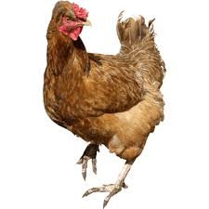
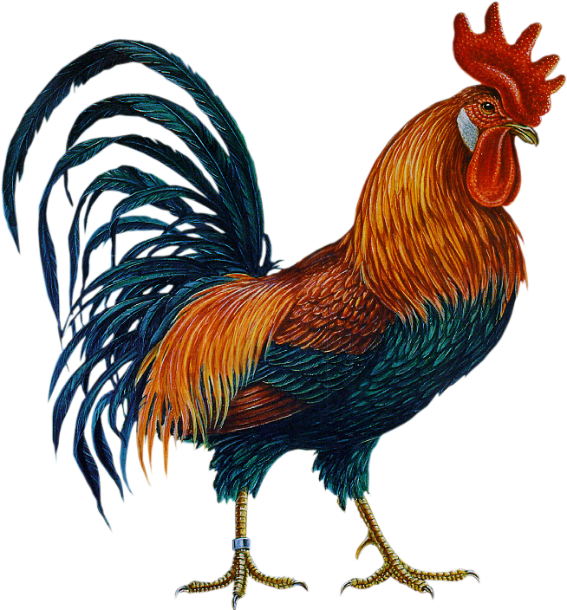
Variant dependent & Independent
Dependent
The environment’s temperature and ventilation
Temperature will be counted in Celsius
The ventilation will be counted as cubic meters as airs for individual chicken
Independent
The chicken’s disease rate
The amount of unique diseases that appeared
The total amount of disease that appeared that day

Slide 6
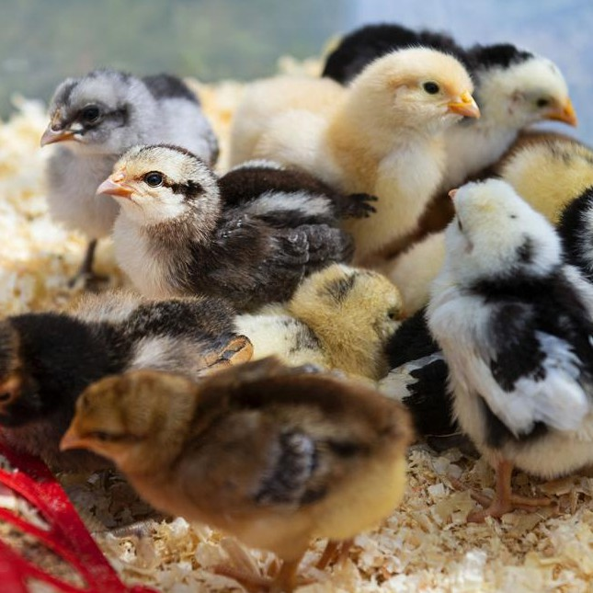
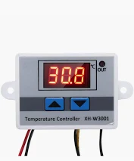
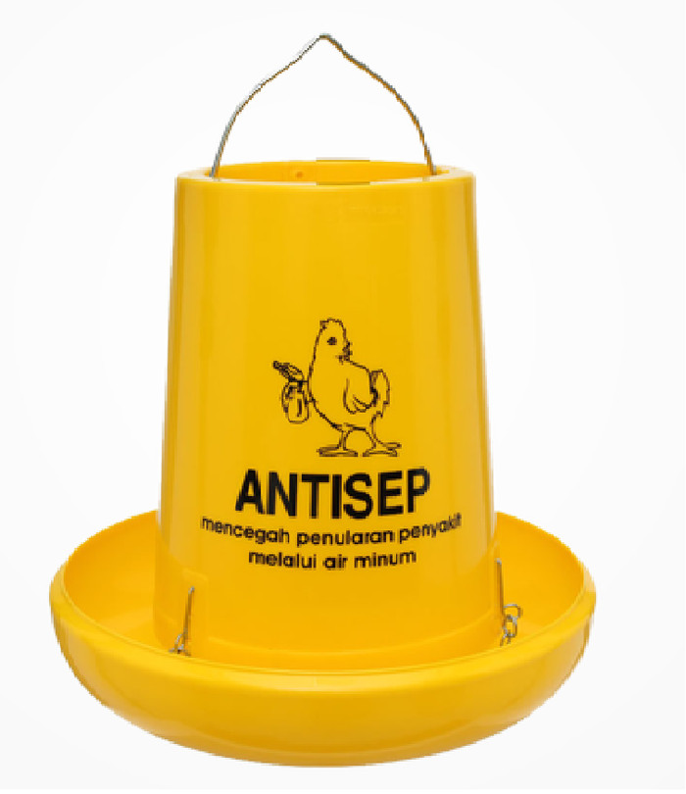
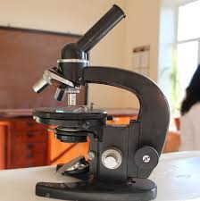
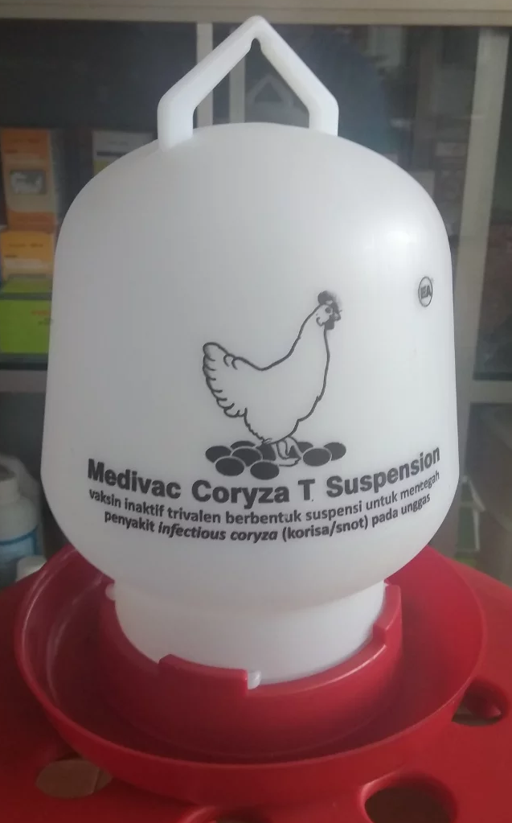
Tools and materials
No. | Name | Picture | No. | Name | Picture
1. | Native chickens |  | 4. | Temperature controller
2. | Food dispenser |  | 5. | Microscope
3. | Water dispenser |  | 6.

Slide 7
Data collection
No. | Dates | High temperature (30-35°C (86-95°F)) | Low temperature (10-15°C (50-59°F)) | High vent | Low vent
 | X/XX/XX | LIST OF PARASITES OR DISEASE APPEARING | LIST OF PARASITES OR DISEASE APPEARING | LIST OF PARASITES OR DISEASE APPEARING | LIST OF PARASITES OR DISEASE APPEARING
 | X/XX/XX
3. | X/XX/XX
AMOUNT OF PARASITES OR DISEASES THAT APPEARED

Slide 8
Timeline plan
Month | January | February |  | March | April | May | June
Week Date | 15-20 | 2-4 | 1, 4, 7, 10, 13, 16, 19, 22, 25, 28 | 1, 4, 7, 10, 13, 16, 19, 22, 25, 28 | 1, 4, 7, 10, 13, 16, 19, 22, 25, 28 | 1, 4, 7, 10, 13, 16, 19, 22, 25, 28 | 1, 4, 7, 10, 13, 16, 19, 22, 25, 28
Creating the 4 rooms
Placing in the chickens
Collecting the data
Report Writing

Slide 9
Procedure
Testing field
Objective: Creating environments for finding the diseases or parasites Methodology:
We will be creating 4 different rooms, the rooms consist of low temperature, high temperature, low ventilation, and high ventilation
We will then separate the rooms by 2, the temperature rooms and the ventilation rooms
The ventilation rooms will have the average temperatures while the temperature rooms will have the average ventilations
High temperature room will have around 30-35°C (86-95°F) while the low temperature room will have around 10-15°C (50-59°F). The ventilation will be 4-6 cubic meters of air per kg of live chicken
Low ventilation rooms will be 1-2 cubic meters of air per kg of live chicken while the high ventilation rooms will be around 4-6 cubic meters of air per kg of live chicken. While the temperature will be 65-75°F (18-24°C)

Slide 10
No. | Name | Quantity | Cost | Link
1. | Baby native chickens | ~40 | Rp. 8.500,00 each | Link
2. | Food dispenser | 1 | Rp 36.000,00 each | Link
3. | Water dispenser | 4 | Rp. 17.000,00 each | Link
4. | Temperature controller | 2 | Rp. 27.000,00 each | Link
5. | Food and water | For 3 months | Rp. 0,00
Total = Rp. 498.000,00

Slide 11
The prevalence of diseases or parasites in native chickens based on their environment
Fazl Nazheef LVL 10

